Slide 1
Yellow Peril
Sinophobia in Australia’s past and present

Slide 2
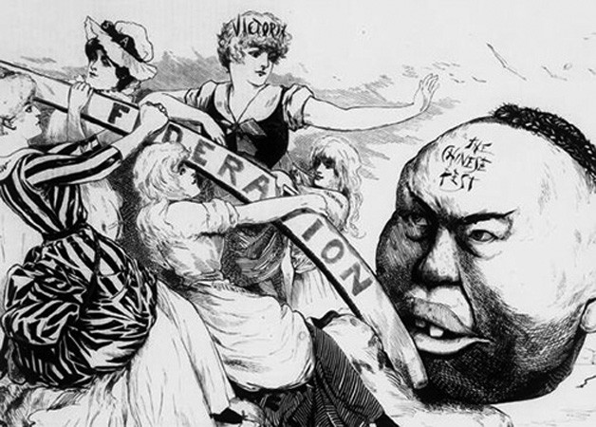
What I will cover:
What does it mean to be Chinese?
Anti-Chinese racism in Australian history
How Australia sees China now
How Sinophobia manifests today (COVID-19, foreign interference)
How the current situation in Australia is different to the past
Source: Melbourne Punch on 10 May 1888.

Slide 3
What does it mean to be Chinese?
The Chinese diaspora is estimated at 60 million
No English equivalent to the important distinctions between huárén (华人), huáqiao (华侨) and Zhōngguó rén (中国人)
Australia has the fifth largest Chinese diaspora as a % of population in the world and largest outside of Asia
City | Population | %
Sydney | 488,000 | 10.8
Melbourne | 356,000 | 8.5
National | 1,214,000 | 5.6
Source: Census 2016

Slide 4
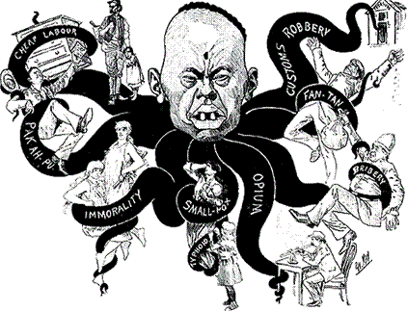
Anti-Chinese racism in Australian history
Victoria passed the first anti-Chinese laws in 1858
Creation of an Australian national identity counterposed to the “Chinaman”
Exclusion of Chinese migration was a key driver behind Federation
Anti-Asian sentiment in the 1980s-1990s
Growing shift from domestic concern about migration undercutting wages to contesting middle-class status (selective schools, property, etc)
Source: Anti-Chinese Cartoon from The Bulletin, 1886

Slide 5
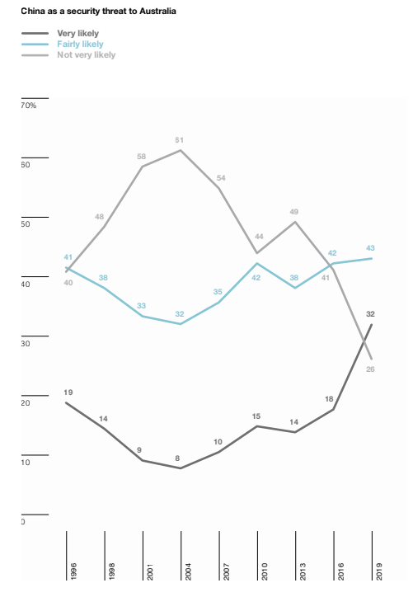
How Australia sees China has shifted
The narrative about China has shifted rapidly since 2018 and it is increasingly seen as a security threat.
Community has shifted only after elites in our institutions (security, media, politics) has become more publicly vocal.
Newspaper articles about “Chinese interference” increased dramatically (40 in 2016, 331 in 2017, 747 in 2018, nearly 500 in 2019)
Perceived national security threats not only relate to military actions in the region (e.g. South China Sea) but potential domestic influence over economy through foreign ownership (e.g. Darwin Port, Huawei), loss of sovereignty and politics (e.g. donations).
Source: Trends in Australian Political Opinion Results from the Australian Election Study 1987–2019

Slide 6
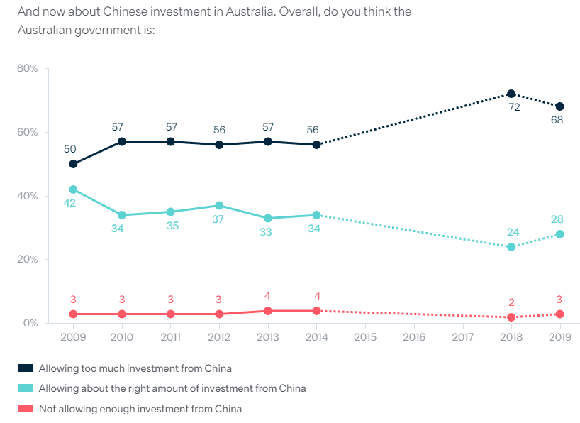
How Australia sees China has shifted
The 2019 Lowy Institute poll found:
“Australians’ trust in China has declined dramatically to 32% in 2019 (down 20 points from last year).
Nearly three-quarters of Australians (74%) agree ‘Australia is too economically dependent on China’, even though a majority (55%) agreed in 2018 that China was ‘the world’s leading economic power’.
Almost half (49%) in 2019 say foreign interference in Australian politics is ‘a critical threat’ to Australia’s vital interests, an increase of 8 points from 2018.
Potential reasons for public shift may include unrest in Hong Kong, Gladys Liu, ICAC investigations into NSW Labor
Source: Lowy Institute 2019 poll

Slide 7
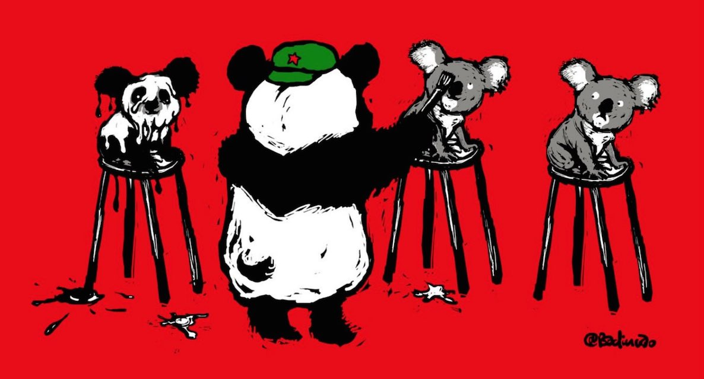
Foreign interference debate
Opaque debate occurring via media or privately
Party-state narrative suggest anything with a link to China as potential threat including Chinese Australians
Downplaying of racism as less of a threat because of CCP narrative about criticism as racism
Divisions not along Left-Right political axis
Salience due to low trust in democratic institutions
Genuine fear of both the CCP and also being accused of being UFWD exists
Artist: 巴丢草 @badiucao

Slide 8
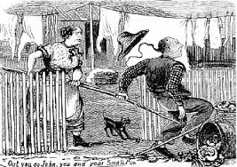
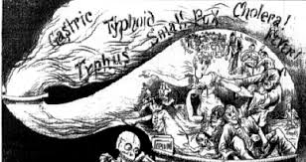
Corona virus (COVID-19)
Overt examples of discrimination and racism towards Chinese and Asian Australians (public transport, hospitals, housing)
Racialised narratives about hygiene and sickness as well as “hoarding”
Community failure to understand casual racism does not require hatred or malice i.e. “It’s fear, not racism” argument
Source: Sydney News, 9 July 1881
Source: Queensland Figaro, 13 March 1888

Slide 9
The current situation is different
Big shift in Australian public’s view of China in 2019 with growing perception of China as a threat.
Perceived overreliance on China economically and “loss of sovereignty” adds to public fears
Historic and country defining anti-Chinese narratives feed into current narratives about foreign interference and COVID-19, aided by past racialised public anxieties which were pushed in the media.
Fear of China and community failure to understand casual and structural racism worsen situation.
No clear political allies, diverse community views and lack of public Chinese Australians voices make it more difficult to create a strong alliance to combat it.
Sizeable minority of Australian residents with Chinese heritage at risk of being collateral damage.

Slide 10
Questions?

